Slide 1
Integrated Care
Better health outcomes through working together
Dr Teresa Anderson
Chief Executive
Sydney Local Health District
March 2016

Slide 2
SLHD Index of Social Disadvantage

Slide 3
History of Collaboration
SLHD has a long history of working together with partner organisations in primary health, community and social services:
Former Medicare Local
Central and Eastern Sydney PHN and primary care
Family and Community Services
Department of Education and Training
Universities and Medical Research Institutes
NGOs
Local Councils

Slide 4
Integration initiatives
SLHD has a range of activities which are improving care integration:
Vulnerable Populations
Aged and Chronic Care
Mental Health
Systems and Supports

Slide 5
Vulnerable populations
In October 2014, the Social Policy Cabinet Committee (SPCC) approved Government testing different service delivery and governance models with a focus on prevention and early intervention.
Four launch sites Sydney; Western Sydney; Central Coast and Illawarra
Service Delivery Reform in Central Sydney renamed: Healthy, Strong Communities

Slide 6
Healthy Strong Communities in Central Sydney
Vision: People who experience difficulty as a result of mental health issues live in stable homes within safe, inclusive communities and receive better targeted and integrated services in the community at an earlier stage to enhance wellbeing.
Consortium of government, non-government, and consumer representatives.

Slide 7
Current Initiatives under Healthy Strong Communities
Pathways to Community Housing (mental health initiative)
Redlink (Waterloo Towers)
Healthy Homes and Neighbourhoods

Slide 8
Cross-agency Child Health & Wellbeing Plan
Senior Partnership & Planning Committee from 2013 with:
Sydney LHD; Family & Community Services; Medicare Local/Primary Health Network; Department of Education; Child Health NGOs
Focus of committee has been collaborative planning for integrated care and associated governance structures
Minister for Health launched the ‘Inner West Child Health & Wellbeing Plan 2015-2020’ in November 2015
Confirms cross-agency commitment to a shared vision, objectives and collaborative action over 5 year period

Slide 10
Cross-agency Youth Health & Wellbeing Plan
Current priority for the Senior Partnership & Planning Committee is development of an Inner West Youth Health & Wellbeing Plan 2016-2021
Same collection of partner agencies with the addition of youth health NGOs
Youth Consultants will participate in planning process and facilitate consultation with young people

Slide 11
Aged Care and Chronic Disease
Connecting Care:
Rehabilitation services
Care coordination
Telephone coaching and support
Xtend- new program being developed use of AINs visiting within 24 hours post discharge for an extended period
Charles Perkins Centre
Outreach into Residential Aged Care Facilities

Slide 12
Mental Health
Living Well, Living Longer
Pathways to Community Housing
Mental Health Atlas

Slide 13
Systems and Supports
Information and Communications Technology (ICT plan for SLHD)
HealthPathways Sydney
Sydney Health Partners
Public Health Observatory
HealthOne to address Urban Growth in Green Square
Health Equity Research and Development Unit
Example: Can Get Health in Canterbury LGA

Slide 14
NSW Health Planning and Innovation Fund
SLHD successful in receiving funding for two integrated care projects:
Healthy Homes and Neighbourhoods
Living Well, Living Longer

Slide 15
Healthy Homes and Neighbourhoods
Issues Identified:
Families with trans-generational disadvantage and psychological trauma
Complexity of family needs, poor engagement by families with services
Poor engagement by services with families
Interventions usually of short duration
Needs of adult family members often not addressed
Barriers to cross-agency collaboration

Slide 16
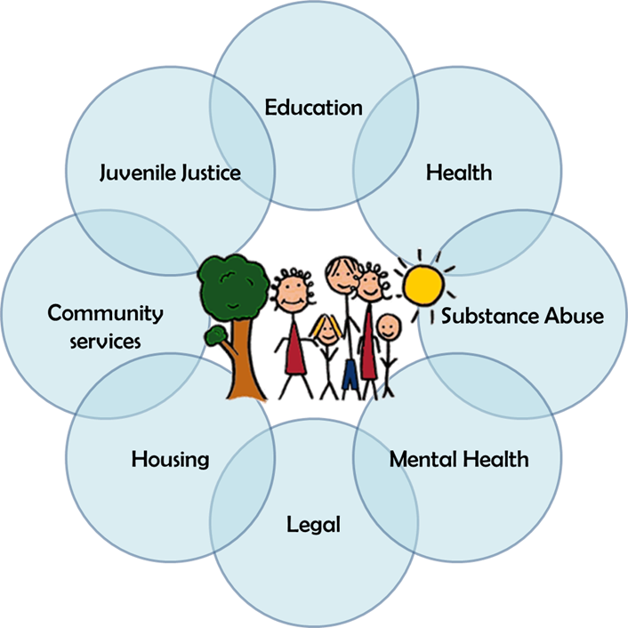
Healthy Homes and Neighbourhoods
Core Partners:
Sydney LHD
Family & Community Services
Primary Health Network
Child & Family NGOs
Department of Education
NSW Police
NSW Juvenile Justice

Slide 17
Healthy Homes and Neighbourhoods
Long-term care coordination for vulnerable families with complex health and social care needs with one or more dependent children (unborn to 17 years), who require multi-agency support Key Features:
Multiple agencies working together
All the needs of families are in scope including housing, employment and legal
Early intervention and public health approach
Supporting general practice with shared assessment tools and referral criteria.

Slide 18
Living Well, Living Longer
District-wide approach to improving physical health and wellbeing in people living with mental illness:
ccCHiP (collaborative centre for cardiometabolic health in psychosis) specialist clinics
GP and Mental Health Collaborative Care
Guidelines for Physical Assessment in Community MH
Oral Health services
Smoking Cessation supports
Exercise and Dietetics interventions

Slide 19
ccCHIP Clinics
One-stop specialist review of cardiometabolic health at Concord and Charles Perkins Centre clinics:
Cardiology, endocrinology, psychiatry
Dietetics, Exercise physiology
Dental assessment
Foot check and sleep screen
363 attendances to date

Slide 20
GP and Mental Health Collaborative Care
Improving primary care for consumers of SLHD Mental Health Service by strengthening connections between clients, GPs and Mental Health clinicians.
Initial joint visit with client, care coordinator and GP to develop care plan; annual health check and case conference to update care.
Improvements from 62% to 89% of consumers with a current GP; from 22% to 35% with annual health check in file.

Slide 21
Living Well, Living Longer
NSW Health Integrated Care Planning and Innovation Fund ‘innovator’ grant received to support:
New peer support workers
Expanding ccCHiP clinics
Oral Health Clinics
Smoking Cessation Clinics

Slide 22
Peer Support: driving consumer-led care
Four Peer Support Worker positions (3.6FTE) based in Camperdown and Croydon Community MH Core Teams
Models of care and professional networks developed in collaboration with Partners in Recovery.
Linked with 45 clients and working on various activities, e.g.:
Referral to community activities such as YMCA Brightside
Walking with consumers to assist in getting active
Supporting healthy eating including grocery shopping
Assisting a consumer to apply for a Deaf Society grant to subsidise a computer

Slide 23
Integrated Care
Keep learning and innovating
Keep the patient and family at the centre of all that you do
Whole of health and wellbeing approach
Respectful Partnerships and shared vision
Good communication
Executive support and leadership across all levels of service
Include the community: e.g. Multicultural community leaders conversation night

