Slide 1
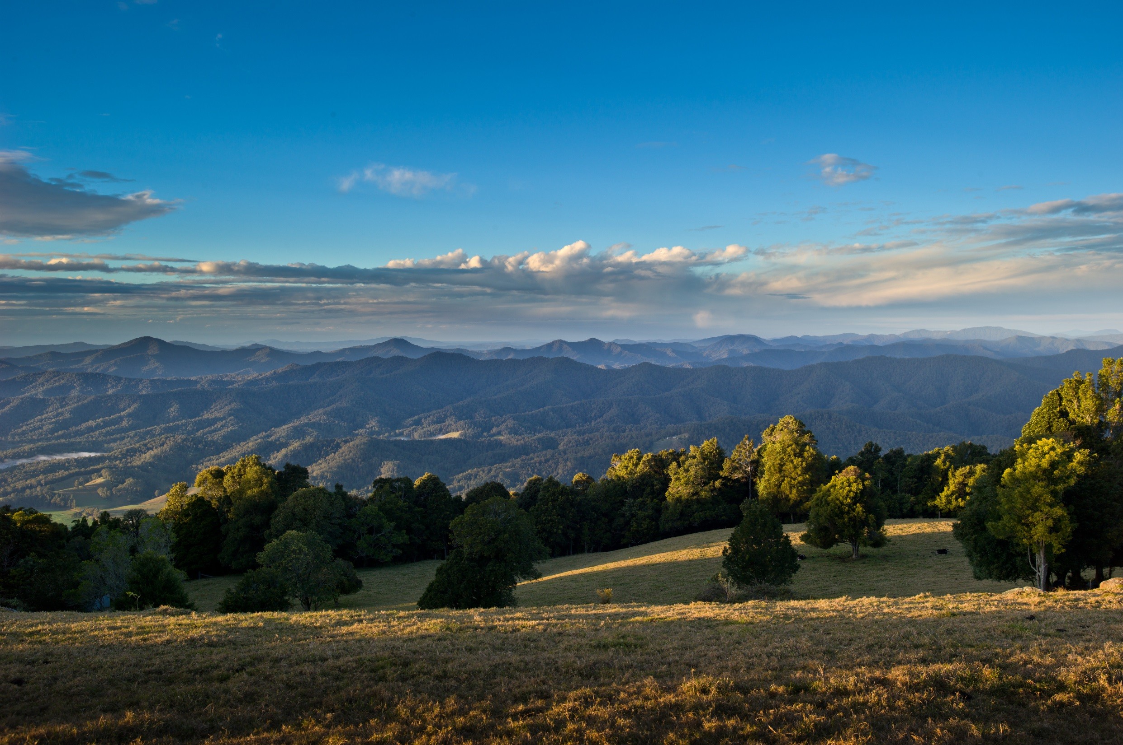

Slide 2
Who are we?
Regionally-based
Multidisciplinary member association
Supporting Allied Health Professionals to improve health outcomes throughout NSW North Coast
Notes:
Regional voice for allied health professionals, private and public
Established with support from NCPHN
Not-for-profit, member-based organisation
Governed by skills-based Board

Slide 3
What we do
Work across:
All allied health disciplines
All sectors of employment (public, private, not-for-profit)
Notes:
There are approximately 1100 allied health professionals working on the NSW North Coast.
Established with support from NCPHN
Not-for-profit, member-based organisation
Governed by skills-based Board

Slide 4
Who we work with
Includes but not limited to:
Audiology
Dietetics
Exercise Physiology
Occupational Therapy
Optometry
Oral Health
Pharmacy,
Physiotherapy,
Podiatry,
Psychology,
Social Work and
Speech Pathology
Notes:
There are approximately 1100 allied health professionals working on the NSW North Coast.
Established with support from NCPHN
Not-for-profit, member-based organisation
Governed by skills-based Board

Slide 5
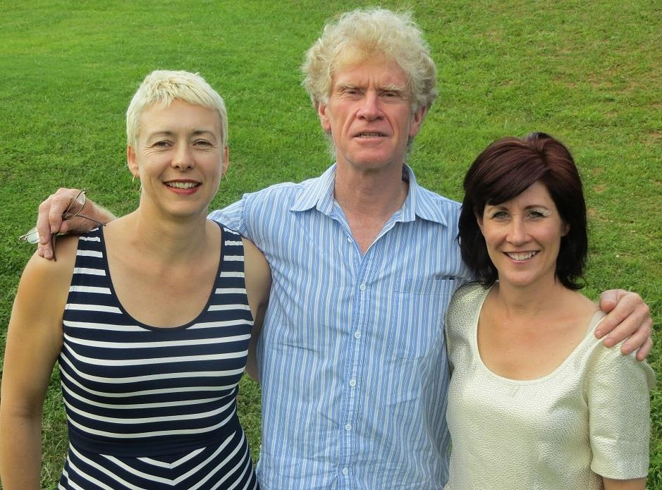
Your Board
Professor Susan Nancarrow (Podiatrist)
Mr Rob Curry (Physiotherapist)
Ms Luisa Eckhardt (Occupational therapist)
Mr Nick Neville (Occupational therapist)

Slide 6
Secretariat support
Ms Robyn Fitzroy
Ms Shay Ataii
Notes:
Board of volunteers
Ongoing support is crucial.
As we’re evolving
- Representation
Recruiting
PHN provides secretariat support 1 day per week
For ongoing sustainability we would ultimately require a CEO

Slide 7
What we’re working towards
Vision
Objectives
Strategic Plan
2014 - 17
Business Plan
‘North Coast NSW community has equitable access to the best health services’

Slide 8
Objectives
Making health care delivery easier by assisting the system to work ‘as one’
Contributing to health planning in the North Coast NSW Region
Improve the quality and appropriate contribution of allied health practice
Enhancing CPD
Improving liaison between Allied Health Practitioners and other areas including general practice
Working with, lobbying and engagement relevant state and national peak professional and government bodies
Notes:
Eg MOU with MNC training group
Roles with SARRAH

Slide 9
Achievements
www.ncaha.org.au
Access to free online CPD in partnership with TAFE & NCPHN
Newsletter, forum, networking events, brokering CPD
Member organisation of NCPHN
Representation on NCPHN Clinical Councils (key regional advisory structure)
Involvement on HealthPathways

Slide 10
Opportunities
Build regional capacity for quality health services
Advocacy and voice for regional AHPs
Support new models of care

Slide 11
Next steps
New members
Upcoming events
AGM
MOU
Notes:
Improving the system of health care by contributing to this group.
Challenge their role from thinking individually work collectively and act strategically.

Slide 12
Acknowledgement of sponsors
North Coast Primary Health Network
Mid North Coast Local Health District
Northern NSW Local Health District
Notes:
Regional voice for allied health professionals, private and public
Established with support from NCPHN
Not-for-profit, member-based organisation
Governed by skills-based Board

Slide 13
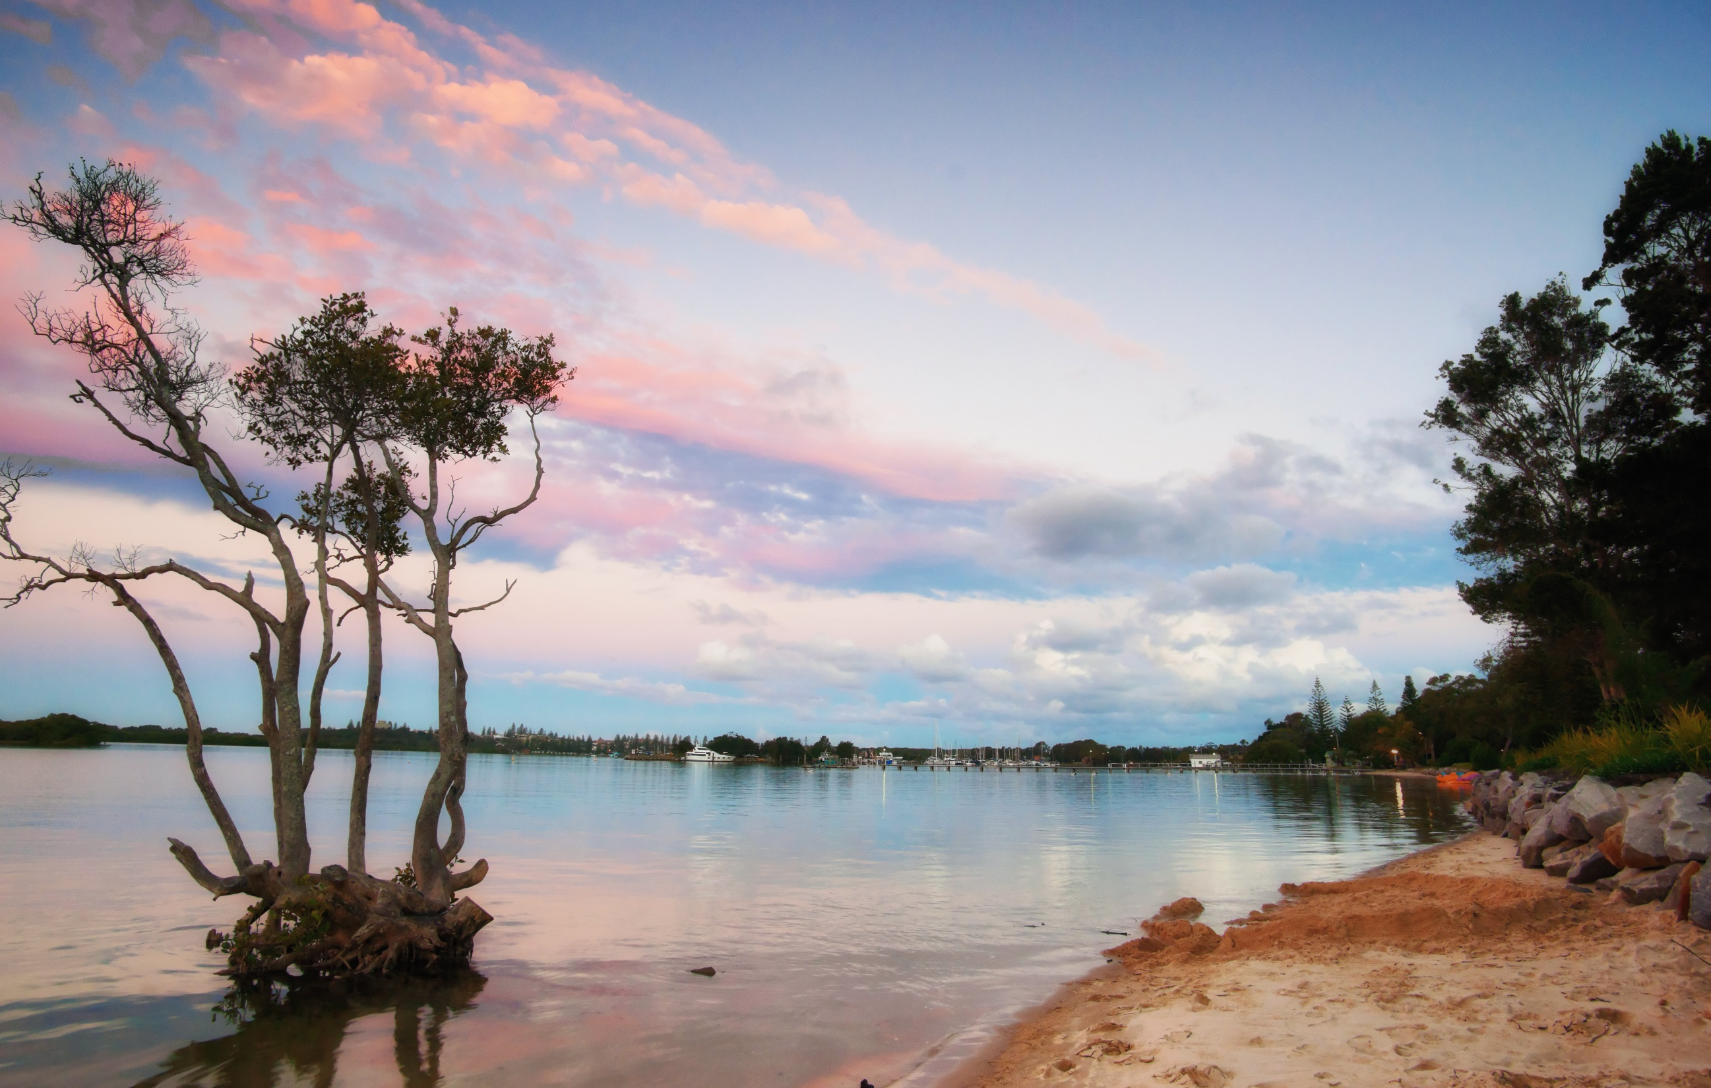
www.ncaha.org.au

