Slide 1
Delivering Innovative Models of Clinical Education
Clinical Educator Workshop
May 2016
Michele Fairbrother
WORK INTEGRATED LEARNING

Slide 2
Workshop Learning Outcomes
1. Adult Learning Principles
2. Common Models of Clinical Placements
3. Alternative Clinical Placement Models
Peer Learning
Team Teaching Model
Peer Supervision Model
Student Led Placement Model
Interprofessional Learning Model
Clinical Simulation Model
4. Workshop Evaluation

Slide 3
ADULT LEARNING PRINCIPLES
Adult Learners:
Have a range of prior knowledge and experience
Need to validate the information learnt according to their values and attitudes
Need to decide what is most important/relevant for their learning needs
Engagement in the learning process must be applicable to real life situations
Want to be actively involved in their learning
Are self motivated – internally driven
Goal oriented
Practical
Enjoy challenges
Have increased powers of comprehension – problem-solving, reflecting, reasoning skills
Like to be respected
Notes:
Pause moment:
As facilitators we are building in principles of adult learning:
Building on prior experiences – help them apply life experiences to new learning. However , may have ingrained ideas about things.
As IP supervisors it is worth raising this with students and adapting to Ipl context. i.e. your expectations as an IP supervisor of the students; what principles you are working from.

Slide 4
ADULT LEARNING PRINCIPLES
Knowles 1990 Adult Learning Assumptions
The need to know — adult learners need to know why they need to learn something before undertaking to learn it.
Learner self-concept —adults need to be responsible for their own decisions and to be treated as capable of self-direction
Role of learners' experience —adult learners have a variety of experiences of life which represent the richest resource for learning. These experiences are however imbued with bias and presupposition.
Readiness to learn —adults are ready to learn those things they need to know in order to cope effectively with life situations.
Orientation to learning —adults are motivated to learn to the extent that they perceive that it will help them perform tasks they confront in their life situations.
Read more: Knowles' andragogy: an angle on adult learning http://www.learningandteaching.info/learning/knowlesa.htm#ixzz2YbndbSei

Slide 5
CLINICAL PLACEMENT MODELS
How do you currently conduct your placement?
How many students?
How do you supervise?
What learning activities do you include?
How do you manage your time?

Slide 6
COMMON MODELS OF CLINICAL PLACEMENTS
Common Models
1:1 model
‘Uni-disciplinary’
‘The students are here to see client’
Delivered with focus on specific areas of practice i.e. ‘silos’
Multiple students
Other models?
Notes:
Lets make the most out of placement

Slide 7
1:1 MODEL OF CLINICAL PLACEMENT
1:1 Clinical Education Model
ADVANTAGES
Individual guided attention
Departmental productivity is not adversely affected
Less demanding
DISADVANTAGES
Student dependent on one educator for their learning experience
Passive dependence
No value placed on peer assisted/collaborative learning
Direct time commitment by the educator is greater

Slide 8
WORK READINESS
Work readiness
‘the extent to which graduates are perceived to possess the attitudes and attributes that make them prepared or ready for success in the work environment’
- Caballero & Walker (2010)
Notes:
Why do we have clinical placements? What are we aiming to achieve?
What are you actually facilitating…
Focus on learner, not on teaching … include sage on stage versus guide by the side

Slide 9
CATEGORIES AND THEMES RELATING TO WORK READINESS Caballero, C., Walker A., Fuller-Tyszkiewcz, M. (2012). The Workreadiness Scale (WRS): Developing a measure to assess work readiness in colleges graduates. Journal of Teaching and Learning for Graduate Employability, 2(2), 41-54.
CATEGORY | THEMES
Motivation | Commitment, drive, persistence, achievement orientation
Maturity | Sense of responsibility/accountability, self awareness, mental/emotional maturity
Personal growth /development | Willingness to learn, openness to feedback, developmental insight
Organisational awareness | Understanding of organisational structures, awareness of organisational culture, rule/process conscious
Technical focus | Confidence in technical skills/technical knowledge, initiative, personal structure, task management
Interpersonal orientation | Communication skills, social confidence, collaboration/teamwork, building relationships/engaging with others, social intelligence
Attitudes to work | Optimism, respect for others, realistic expectations, humility
Problem solving | Analytical/evaluative, decision making, ideas generation
Adaptability | Open to change(flexibility) acceptance of diversity, able to adapt behaviour
Resilience | Resilience to negative feedback, capacity to deal with competing work demands/challenges
Notes:
Increasingly employers are seeking graduands with highly developed generic attributes as opposed to technical skills which are more likely to be acquired within the context in which they are needed.
Garling report (related to students acquiring high level skills)
http://www.dpc.nsw.gov.au/__data/assets/pdf_file/0003/34194/Overview_-_Special_Commission_Of_Inquiry_Into_Acute_Care_Services_In_New_South_Wales_Public_Hospitals.pdf

Slide 10
Work Readiness Questionnaire
Rank the importance of the following attributes in a new graduate
Work Readiness Questionnaire | 0 NOT IMPORTANT | 1 SOMEWHAT IMPORTANT | 2 NEUTRAL | 3 IDEAL | 4 CRITICAL
Motivated
Sense of responsibility/accountability
Willingness to learn
Awareness of organisational structure
Assessment skills for specific client populations
Communication skills
Self management skills
Technical knowledge
Flexibility
Attitudes to work
Problem solving
Adaptability
Resilience
Notes:
How much focus do we give to delivering theses qualities in our current placement models?

Slide 11
ALTERNATIVE CLINICAL PLACEMENT MODELS

Slide 12
ALTERNATIVE CLINICAL PLACEMENT MODELS
CONSIDER …
Which of the following models could you implement or re-model within in your clinical area or department
What are the
Enablers
Challenges/Barriers

Slide 13
Peer Learning Model
The collaborative nature of peer learning reinforces the social and constructed nature of knowledge, in which discourse and communication are fundamental (Sullivan Palincsar, 1998)

Slide 14
PEER LEARNING MODEL
Peer Learning
Peer learning is based on sound pedagogical principles
The collaborative nature of peer learning reinforces the social and constructed nature of knowledge, in which discourse and communication are fundamental
(Sullivan Palincsar, 1998)
Notes:
– not just a way for universities to increase placements

Slide 15
PEER LEARNING MODEL
ADVANTAGES FOR STUDENTS:
Improves teaching skills
Encourages self directed/lifelong learning (more indepth learning)
Safe and supportive
Freedom to experience
Supports emotional/social and clinical skills
Builds confidence and resilience
Strengthens the students strengths (have to function at a higher cognitive level)
Fosters work readiness skills
Assists develop accountability/responsibility for actions
Can decrease anxiety
More project based

Slide 16
PEER LEARNING MODEL
ADVANTAGES FOR EDUCATORS:
Increased time for supervision through caseload delegation
Reduced stress
Increased time for planning
Reduced student dependency/frees supervisor time
Develops greater interpersonal management skills
Increased productivity
Promotes cohesiveness
Allows for a structured or unstructured learning environment

Slide 17
PEER LEARNING MODEL
Recommendations - Setting-up for peer learning
Ground Rules
Need to understand the concept of leadership, conflict management and decision making
Have specific time frames for debriefing and reporting back on given tasks
Learning contracts - Costa, D.M (2007); Whitcombe, S.W (2001)
Identify different learning styles and needs
Adequate preparation
Costa, D.M (2007). Using learning contracts in fieldwork education. OT Practice,12(12), 11-12.
Whitcombe, S.W (2001). Using learning contracts in fieldwork education: The views of occupational therapy students and those responsible for their supervision. British Journal of Occupational Therapy, 64, 552-558.

Slide 18
PEER LEARNING MODEL
Recommendations for the implementation of peer learning
Adequate preparation
Allocate time for supervision
Allocate time for individual tasks
Provide individual feedback prior to peer discussion
Facilitate goal setting (collaborative approach)
Use learning contracts for clarity of expectations
Identify different learning styles and needs (change approach for struggling student)
Notes:
Provide allocated time for individual supervision from educator
Individual feedback prior to peer discussion
Use a test early on to determine knowledge base
Allocate time for individual tasks
Educator sets goals
Learning contracts to be drawn up
Apply self experience first
Identify different learning styles and needs (may need to change approach for a struggling student)
Take own workload even when it is shared
Have specific time frames for debriefing and reporting back on given tasks
Educator must afford equal opportunities to all students
Reflection undertaken by the educator must not be biased

Slide 19
PEER LEARNING MODEL
Recommendations for the implementation of peer learning
Ensure individual and shared caseload for students
Designate specific time frames for debriefing and reporting on given tasks
Afford equal opportunities to all students
Reflection undertaken by the educator must not be biased
Need to understand the concept of leadership, conflict management and decision making
Making greater use of critical reflection by students
Obtaining further feedback on student performance from other stakeholders
Notes:
Need to understand the concept of leadership, conflict management and decision making
Adequate preparation- be very organised, have timetables so that students know exactly when they have different activities, 1:1 feedback.
Give students homework to minimise wasted hours e.g. Get students to research different conditions that they will encounter the next day
Grade client complexity based on learning needs
Encourage self learning- try to work it out before you ask the supervisor
Be adaptable- may need to call on various learning strategies, resources etc.

Slide 20
PEER LEARNING MODEL
Recommendations - Improving the rigor / challenge of peer learning
Baldry Currens, J. (2010). Preparing for learning together in fieldwork education practice settings. (pp. 309-317). In McAllister L, Paterson M, Higgs J, Bithell C (Eds.) Innovations in allied health fieldwork education: A critical appraisal. Rotterdam, The Netherlands: Sense Publications.
2 TYPES OF PEER LEARNING
Dialogic Collaboration
Questioning
Clarifying
Exchanging
Rich, co-constructed dialogues
Activity-Based Collaboration
Modelling
Rehearsing
Reviewing
Tutoring
Notes:
QUESTIONING
Students work together to:
answer the simple questions
construct more precise high level questions
They need input into answering
CLARIFYING
Thinking aloud with peers to reframe and make sense of ideas, situations and concepts
EXCHANGING
Sharing/trading resources, knowledge, skills
RICH, CO-CONSTRUCTED DIALOGUES
Probing & challenging assumptions, perspectives & cognitive conflicts

Slide 21
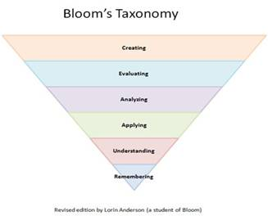
PEER LEARNING MODEL
Recommendations - Peer learning activities
Peer Supervision & Feedback
The Teaching Clinic
Case Based
Component of Assessment or Intervention
Interprofessional Case Presentations
Interprofessional Job Shadowing
Students resource development
Journal Club
Notes:
Tutorial Content
Case Presentation
Journal Club
Posters
Resource Folder
Documentation/ Medical records
Practical task /sequence of tasks
Inter-professional Case Discussion (large group activity)

Slide 22
PEER LEARNING MODEL
Challenges to the peer learning model
Students become reliant on each other and possibly less likely to learn
Development of poor learning habits
Different levels of motivation and abilities
Challenges to supervision/management of multiple students (focussing on “good” or “bad” students more)
Uneven learning opportunities
Possibility of increased distraction e.g. not task focussed
Different learning styles/ harder to focus on individual needs
Conflict between peers, personality clashes (passivity vs. dominance vs. individualism)
Notes:
Students want a certain amount of direction and if it is not given may not seek assistance when it is truly required
Weaker students taking a ‘back seat’ or their weaknesses are hidden
More than one weak student in the group

Slide 23
PEER LEARNING MODEL
Challenges to the peer learning model
Conflict between supervisors when comparing student progress
Reduced individual accountability
Space confinements
Increased workload
Patient concerns
Ensuring adequate individual feedback
Notes:
More students = increased number of assessments/ marking
may overwhelm patient
(too many students involved in their care)

Slide 24
PEER LEARNING MODEL
Success of peer learning model relies on:
Developing strategies for dealing with multiple students
Delegating the caseload to students
Requires the support of other staff, especially early in placement
Understanding and knowing how to best utilise peer learning opportunities
Currens (2003)

Slide 25
Team Teaching Model
Alternative model to one person being solely responsible therefore may reduce the stress and assists with time management.

Slide 26
TEAM TEACHING MODEL
Role of the Educator as Manager
Organising and structuring placements in collaboration with key stakeholders
Providing supportive learning environment ,ensuring the provision of adequate educational and physical resources
Understanding university requirements and learning goals, assessment
McLeod, Romanini, Cihn and Higgs (1997) Brown and Kennedy Jones (2005)

Slide 27
TEAM TEACHING MODEL
Team Teaching Approach
The attributes most important in a physiotherapy CE were approachability, enthusiasm and good communication skills (Bennett, 2003).
Are these attributes within the capability of your more junior staff?
A senior educator takes on the manager role BUT junior staff can gain from this experience through improvement in responsibility, personal knowledge, teaching skills and peer learning.
Senior students may also take more responsibility by identifying their own learning opportunities.
Notes:
Perhaps not realistic to have junior staff solely responsible for students education
Peer learning for junior staff from more experienced staff

Slide 28
TEAM TEACHING MODEL
Advantages of Team Teaching
Support/sharing the responsibility of student education.
Promotes independence/autonomy/creativity (explore different perspectives and experiences)
Learning from one another
Students exposed to multiple teaching styles
Encourages flexibility/adaptability/resilience/technical focus
Less likely to have personality clashes
More reflective of the real work environment – teamwork
Efficiency of staff time (improved time management)
Greater variety for the students (clients, caseload , clinical settings and service delivery)
Promotion of professional growth
Notes:
promotes the concept of sharing
Support for both and students
(different perspectives of the student from different clinicians)

Slide 29
TEAM TEACHING MODEL
Advantages of Team Teaching:
Facilitates communication, motivation and group learning
Allows for expanded roles within the department
Up-skilling of younger clinicians
Allows for continuum of care (holistic experience/perspective)

Slide 30
TEAM TEACHING MODEL
Challenges of Team Teaching:
Need for multiple staff -problematic if staff shortages.
Demanding
Teaching may become fragmented/inconsistent resulting in students becoming confused with different styles and techniques.
Conflicting aims/goals of the clinicians
Communication/management - if team members do not communicate with each other, student can become confused by differing feedback/ goals
Duplication
Notes:
The struggling student will find this approach difficult due to too many contexts/approaches

Slide 31
TEAM TEACHING MODEL
Challenges of Team Teaching:
Increased time required for collaboration
Reduced focus on core competency skills
Staffing of the same stream (educators lacking ownership)
Students with low motivation may slip through the cracks
Inadequate information/feedback on students especially the struggling student.
Student isolation if on placement alone

Slide 32
TEAM TEACHING MODEL
Recommendations for Team Teaching:
Thorough planning (ensure student numbers are appropriate to department size and number of staff available to take students)
Detailed weekly schedule
Nominate a team leader who will ensure the focus is maintained on problem solving, learning goals, professional development and team dynamics- contact person for conflict
Discussion of educator strengths/weaknesses prior to placement: tailor placement according to teaching styles
Select educators who are enthusiastic about taking students-up-skill staff
Notes:
(regular meetings between educators, timetable of education sessions and who would be leading them)

Slide 33
TEAM TEACHING MODEL
Recommendations for Team Teaching:
Orientation/induction with students outlining clear expectations/objectives/goals
Ensure university contact
Ensure clear paper trail e.g. communication book
Encourage peer support/learning by rotating the students during the placement
Encourage students to self reflect/evaluate
Ensure student knows who to contact if they feel out of their depth

Slide 34
Peer Supervision Model

Slide 35
PEER SUPERVISION MODEL
Peer Supervision Model
More experienced student paired with one or more less experienced students
The more experienced student takes on part of the role of educator
Educator remain overall manager of learning to ensure quality of knowledge and skills being transmitted
Senior students gain mentoring and leadership skills; requires them to function at a higher cognitive level
Solidifies the students knowledge and skills through teaching someone else
Notes:
(e.g.. 4th year with 2nd year undergraduates)

Slide 36
PEER SUPERVISION MODEL
Peer Supervision Model
Less experienced students often perceive that the senior students are more ‘in touch’ with the experience of being a student and are less intimidating, however some perceive they’re not being supervised by a ‘proper’ educator
Educator needs to balance simultaneous needs of students at different levels

Slide 37
PEER SUPERVISION MODEL
Advantages of Peer Supervision Model
Senior students develop supervision/teaching skills
Encourages senior students to reflect on their practice- able to identify gaps in their knowledge
Less experienced get to learn form the more experienced and see what they will be expected to do in the future
Increased exposure to various experiences
Develops communication skills and sense of responsibility
Students may find other students more approachable
Allows clinical educator ‘down’ time
Notes:
Develops motivation

Slide 38
PEER SUPERVISION MODEL
Challenges of Peer Supervision Model
Taking away from learning time for the more experienced student
Challenges in tailoring learning experience to the 2 levels
Placement scheduling
Confusion among supervisors about student’s levels and abilities
Bias towards the more experienced student
?effects on patient continuity of care
Issues if senior students inappropriately mentors junior student
Could be potentially more time consuming for clinical educator
Notes:
If the more experienced student is struggling with their skills

Slide 39
PEER SUPERVISION MODEL
Recommendations for Peer Supervision Model
Preparation and support of senior students in the mentor role
Have a back up 1:1 plan if peer supervision is not appropriate
Orientation/ outline expectations
Allocate time for contact with educator- who to contact if issues arise
Educate students regarding how to mentor e.g. encourage ‘what’, ‘how’, ‘when’ questions as opposed to ‘why’.
Have allocated times to teach students how to appropriately give feedback to each other
Rotate between pairings of students
Communication book:
Allows educator to know what feedback students have been giving each other

Slide 40
Student Led Placement Model

Slide 41
STUDENT LED PLACEMENT MODEL
Student Led Placement Model
Teaching clinics
on university campus
traditional service model
uni-disciplinary
clinical educators manage the clinic & are consistently present
Variety of settings:
outpatient
inpatient
community based

Slide 42
STUDENT LED PLACEMENT MODEL
Student Led Placement Model
Entirely student-led (e.g. Dootagalla, Melbourne);
students manage the entire clinic
invite supervisors in
interprofessional, multidisciplinary.

Slide 43
Clinic example
STUDENT LED PLACEMENT MODEL
Broken Hill Uni Dept Rural Health (Brunero and Merritt)
Context:
Schools; community engaged learning
schools set the priorities – mainly oral language and literacy development
Low risk, high volume clients (Lincoln & Causa, In press )
Service delivery models:
Whole class work
small group work
1:1 withdrawal (traditional therapy)
Notes:
An example of an interprofessional student –led clinic that Syd Uni has been involved with.

Slide 44
Clinic example
STUDENT LED PLACEMENT MODEL
Broken Hill Uni Dept Rural Health (Brunero and Merritt)
Supervision model:
Indirect supervision from discipline supervisor:
Reading treatment plans and reports sent by email and providing feedback correction
Email re information requests
Mobile phones, texts
Skype (students on outreach visit)
Notes:
An example of an interprofessional student –led clinic that Syd Uni has been involved with.

Slide 45
STUDENT LED PLACEMENT MODEL
Advantages of student led placement models
Allows students to become more independent resulting in increased confidence , taking responsibility for their decisions and being creative
Students get a taste of “real life work”
Promotes work readiness skills e.g. building rapport
Students develop time management ,problem solving, prioritisation and teamwork skills
Enhances motivation
Permits peer learning/support opportunities

Slide 46
STUDENT LED PLACEMENT MODEL
Advantages of student led placement models
Provides interdisciplinary opportunities
Allows for peer discussion and learning
Improved time management
Opportunity for quality assurance activity/research
Inexpensive to run
Permits a service to run that might otherwise not be provided

Slide 47
STUDENT LED PLACEMENT MODEL
Challenges of student led placement models
Accountability and job security
Limited by student ability and attitude (dominant personalities taking over)
Student relationship with educators
Not always appropriate to all situations/disciplines
Students might not feel comfortable discussing feeling and difficulties in large peer group settings
Patient/ client satisfaction- being treated by students
Patient acuity

Slide 48
STUDENT LED PLACEMENT MODEL
Challenges of student led placement models
Lack of guidance with difficult patients- students may feel that they don’t get enough supervision and feedback
OH&S concerns- being able to ensure safe and adequate patient care
Inability to prevent “group think”
Lack of co-operation or discrimination from other staff, patients, carers
Space and resources
May not gain work readiness skills
Notes:
Lack of immediate expert opinion

Slide 49
STUDENT LED PLACEMENT MODEL
Recommendations for student led placement models
Research/resource amenable patient groups(instigators to gain experience in other clinics prior to the start)
Positive commitment from staff involved in student led placements to ensure a positive culture
Ensure clients are aware that clinic is student run
Most suitable to final year students
Strict criteria, risk assessment and selection of students and patients ( the appropriate unit/clinic/ward )
“Fail safe” mechanism needs to be in place if students feel unsafe or out of their depth
Ensure a good orientation process
Strict online policies, protocols and procedures available for easy access and support

Slide 50
STUDENT LED PLACEMENT MODEL
Recommendations for student led placement models
Making indirect supervision work better by …
Greater use of critical reflection by students
Improving the rigor/challenge of peer learning
Clinical educator sampling of performance
Obtaining more feedback on student performance from more people
Nominated contact person in school or aged care setting
Teaching clinic monitor or chair

Slide 51
STUDENT LED PLACEMENT MODEL
Recommendations for student led placement models
Timetable reflection time with group and supervisor/s at appropriate intervals during the placement
Initially student may shadow therapist before becoming more independent
Develop protocols for liaising and debriefing with other allied health professionals
Ensure adequate funds are available

Slide 52
Interprofessional Learning Model

Slide 53
INTERPROFESSIONAL LEARNING MODEL
Interprofessional Learning
Students from different disciplines learn about, from and alongside each other in organised activities throughout the placement
e.g. joint case presentations, observation of assessment or intervention, joint projects, etc.
Overall supervision remains with each students’ discipline; interprofessional activities may be supervised by an educator from any of the disciplines
Educators can alternate supervision of the activities, providing ‘time out’ from students for the other educators
Increases capacity for student supervision

Slide 54
INTERPROFESSIONAL LEARNING MODEL
Interprofessional Learning - Benefits for students
Increased understanding and appreciation of other professionals’ roles- holistic approach to patient care
Improved communication skills
(Nisbet, et al., 2008)

Slide 55
INTERPROFESSIONAL LEARNING MODEL
Interprofessional Learning - Considerations
Disciplines involved depends on timing of placements and workplace structure
Practical organisation and planning required in advance
Guaranteed commitment from all disciplines involved
Networking opportunities fostered
Provide time to reflect and build on prior knowledge
Any discipline can assess generic competencies

Slide 56
INTERPROFESSIONAL LEARNING MODEL
Advantages of Interprofessional placements
Holistic focus on patient care
Increased understanding of other professions
Enhances teamwork and communication - promotes peer learning experiences
Joint assessment of patients enhance the learning experience
Use of structured observation activities of other professions
Increased efficiency having more staff involved
Broadens experience
Permits ‘down time’ for educator

Slide 57
INTERPROFESSIONAL LEARNING MODEL
Challenges to Interprofessional placements
Taking time away from developing ‘core’ skills
Timing of placement (more than one discipline would need to be out on clinical at the same time)
Convincing clinicians to come on board
Imposing on other professional’s time
Student reluctance/ lack of understanding why they are doing this
?more suited to stronger students

Slide 58
INTERPROFESSIONAL LEARNING MODEL
Challenges to Interprofessional placements
Different assessment forms
Keeping track of the students
Student learning at university is discipline specific (no common lectures)
May shift focus too far away from own role- struggling students might find this difficult

Slide 59
INTERPROFESSIONAL LEARNING MODEL
Recommendations for Interprofessional placements
Ensure students from different disciplines available
Create multi-disciplinary projects to facilitate learning
Utilise varying degrees of interprofessional practice e.g. may involve interprofessional learning full time or involve visits with other disciplines during traditional placement

Slide 60
Clinical Simulation Model

Slide 61
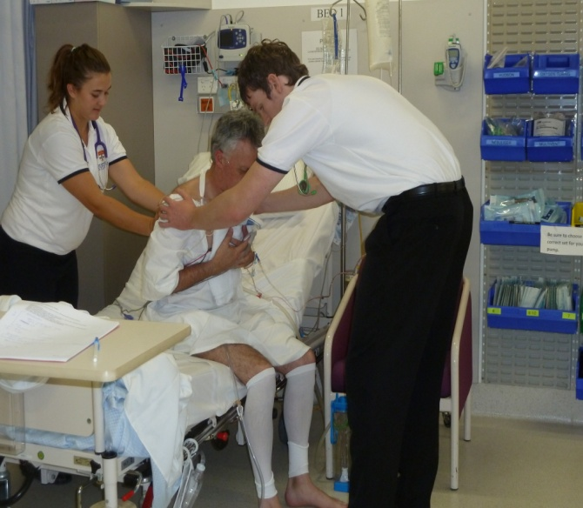
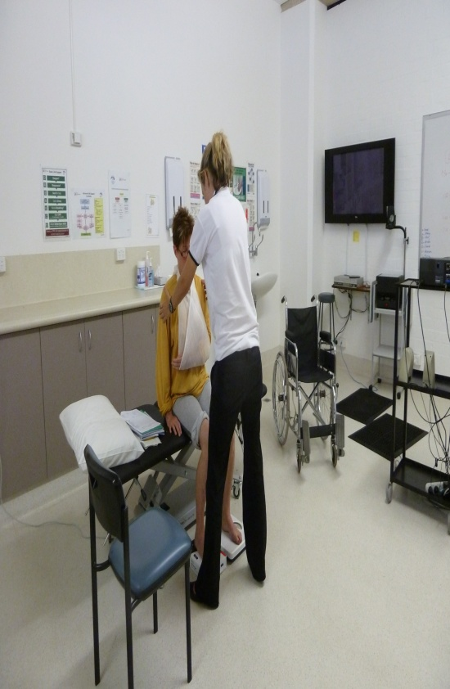
CLINICAL SIMULATION MODEL
Clinical Simulation

Slide 62
CLINICAL SIMULATION MODEL
Clinical Simulation – The Research
A proportion of clinical time can be replaced with simulated learning experiences without compromising the attainment of learning outcomes
(Watson et al, 2012)
Simulation training in health professional education is consistently associated with large effects for outcomes of knowledge, skills, and behaviours and moderate effects for patient-related outcomes
(Cook et al 2011 Systematic Review and Meta analysis)

Slide 63
CLINICAL SIMULATION MODEL
Advantages of Clinical Simulation
students work through clinical interventions with professional actors (high fidelity).
opportunity for repeated practice in a safe environment
control of student exposure to different patient conditions & complexities
opportunities for feedback and learning from actors (‘patients’), educators and peers
timeouts during assessment/treatments
formal debrief following patient interaction
clinical educator availability (no case load of their own)

Slide 64
Guide for remodelling your current placement
Utilise the ‘work ready’ attributes - how can you provide opportunities to develop these?
Look at your workplace and colleagues. Can you better engage them and build a teaching team?
Design independent activities that provides you ‘down time’ from the students – especially using the peer learning principles
Utilisation other disciplines to provide interprofessional opportunities
Is there scope for a student led service that would enhance patient care in your workplace?

Slide 65
Guide to activities to consolidate learning and reduce reliance on the educator
Self reflection - structured tasks
Peer assessment and feedback sessions
Practical practice sessions with peers
Presentation of cases to other students
Self assessment by student

Slide 66
References
Further reading
Bennet R (2003) Perceived abilities/qualities of clinical educators and team supervision of students. Physiotherapy 89 (7) 432-442
Brown L & Kennedy-Jones M (2005) Exploring the roles of the clinical educator: The manager role. In M Rose & D best (eds) Transforming practice through clinical education, professional supervision and mentoring (49-58) Sydney: Elvevier
Caballero C & Walker A (2010) Work readiness in graduate recruitment and selection: A review of current assessment methods. Journal of Teaching and Learning for Graduate Employability 1(1) 13-25
Caballero C, Walker A, Fuller- Tyszkiewcz M (2012) The Work readiness Scale (WRS): Developing a measure to assess work readiness in colleges graduates. Journal of Teaching and Learning for Graduate Employability 2(2) 41-54
Causa and Lincoln (in press). Supervision safety matrix: an approach to managing risk on interprofessional clinical placements. Journal of Interprofessional Care
Currens J, (2003) The 2:1 clinical placement model: Review. Physiotherapy 89 (9) 540-554
McLeod S, Romanini J, Cohn E & Higgs J (1997) Models and roles in clinical education. In L McAllister, M Lincoln, S McLeod & D Maloney (Eds) Facilitating Learning in Clinical Settings (27-64) Sydney: Nelson Thornes
Nisbet, G., Hendry, G. D., Rolls & Field, M. J. (2008). Interprofessional learning for pre-qualification health care students: An outcomes-based evaluation. Journal of interprofessional care, 22(1), 57-68.
Sullivan Palincsar A, (1998) Social constructivist perspectives on teaching and learning. Annual Review of Psychology 49 345-375

Slide 67
Slide title… 28pt font size
Sub-heading bold… 24pt
Body copy… 24pt
Bullet point… 24pt
Bullet point
Heading 1 | Heading 2 | Heading 3
Body copy
xxx
xxx
xxx

Slide 68
Slide title… 28pt font size
Please use this graph to ensure the colour theme is consistent.
Place caption here if required

